Slide 1


WAREHOUSE MANAGEMENT

Slide 2
ABSTRACT
INTRODUCTION
OUR IDEA
IMPLEMENTATION
ADVANTAGES
FUTURE ENHANCEMENT
CONTENTS

Slide 3
ABSTRACT
Warehouse operations are generally invisible to customers, but they play a vital role in ensuring on-time delivery. To achieve this goal, good warehouse management ensures all warehouse processes run as effaiciently and accurately as possible. Ensuring the quality of the product is inevitable. So we have an idea to predict whether the products like grains are on the right conditions to ensure the quality of the grains.

Slide 4
Introduction
The grains has to be stored safely using proper methods of preservation for consistent supply throughout the year. Cereals, as agricultural produce, occupy an important place in human food, as they are primary sources of energy to the majority of the global population.
Ware house management places a vital role in managing the quality and ensuring the trust of the customers who buy the product from the industries.

Slide 5
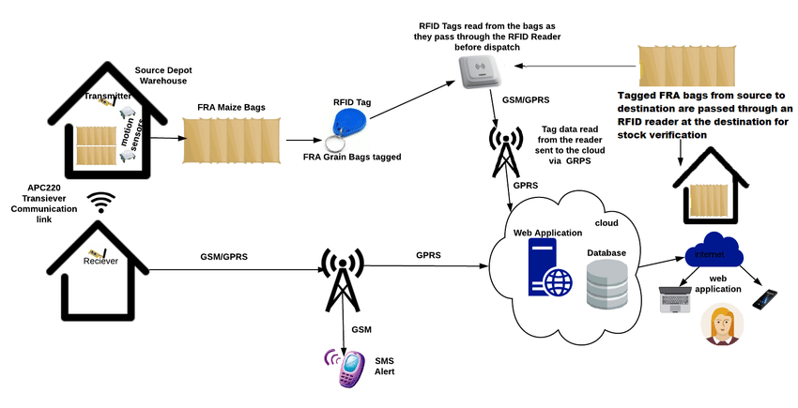
our idea
Inorder to achieve the quality of the grains we are supposed to check the humidity and the temperature continuously.
To achieve this we are attaching sensors like CO2, temperature and humidity. So this sensors continuously monitor the quality of the grains based on the air pressure and surroundings.
If the grains are affected it gives an alarm to the workers over there and alert them before hand.
Additionally, the bugs and insects are detected with the help of passive infrared sensor.
To the extension, through the GSM module, the status of the grains are updated, so that for the workers it will be easy to manage and maintain the grains

Slide 6
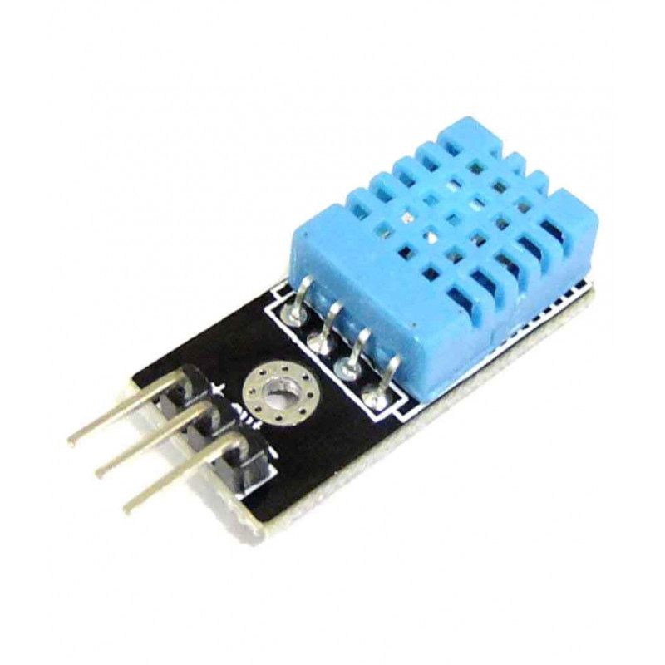
our idea
SENSORS USED:
TEMPERATURE AND HUMIDITY SENSOR:
Temperature and humidity sensor (or rh temp sensor) is devices that can convert temperature and humidity into electrical signals that can easily measure temperature and humidity.
It has high reliability and excellent long-term stability, thanks to the exclusive digital signal acquisition technique and temperature & humidity sensing technology.
Range:
Temperature of 15 °C and humidity of 10 and 12% guarantee maintenance of the quality of the grain stored in a closed system. Correct storage ensures that the grain can have long-term nutraceutical action.

Slide 7
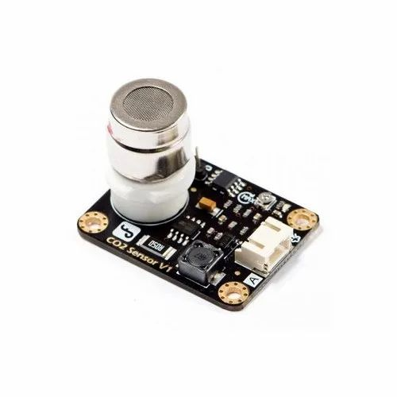
our idea
SENSORS USED:
CO2 SENSOR:
A carbon dioxide (CO2) sensor is a device used to measure the concentration of carbon dioxide gas in the atmosphere.
It is measured using “parts per million” (ppm) and typically has a presence of around 400 ppm.
Range:
The data showed that safe grain storage was observed at CO 2 concentrations of 400 to 500 ppm. Higher concentrations of CO 2 clearly showed mold spoilage or insect activity inside the grain storage silo.

Slide 8
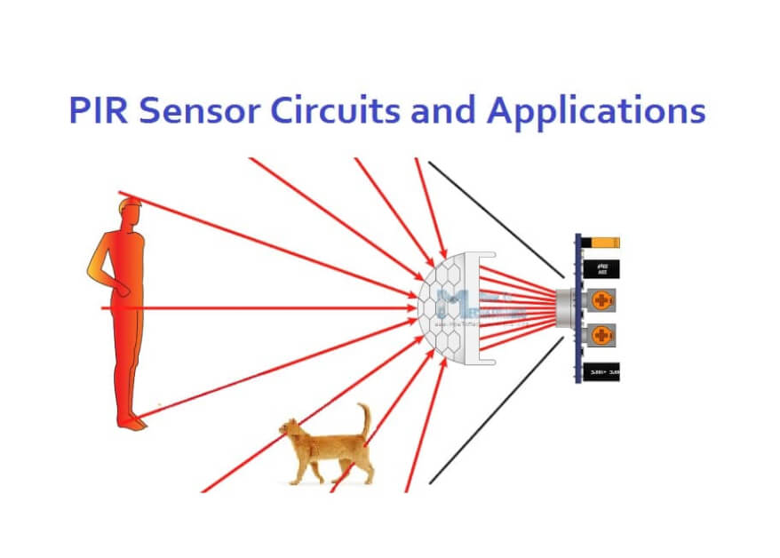
our idea
SENSORS USED:
PASSIVE INFRARED SENSOR:
Passive infrared (PIR) sensors use a pair of pyroelectric sensors to detect heat energy in the surrounding environment. These two sensors sit beside each other, and when the signal differential between the two sensors changes (if a person enters the room, for example), the sensor will engage.
Range:
Since PIR sensors have ranges of up to 10 meters (30 feet), a single detector placed near the entrance is typically all that is necessary for rooms with only a single entrance.

Slide 9
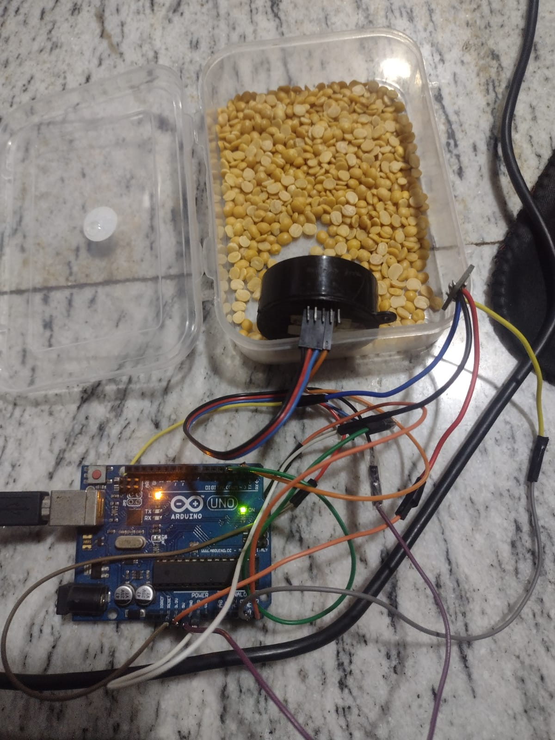
IMPLEMENTATION
PROTOTYPE

Slide 10
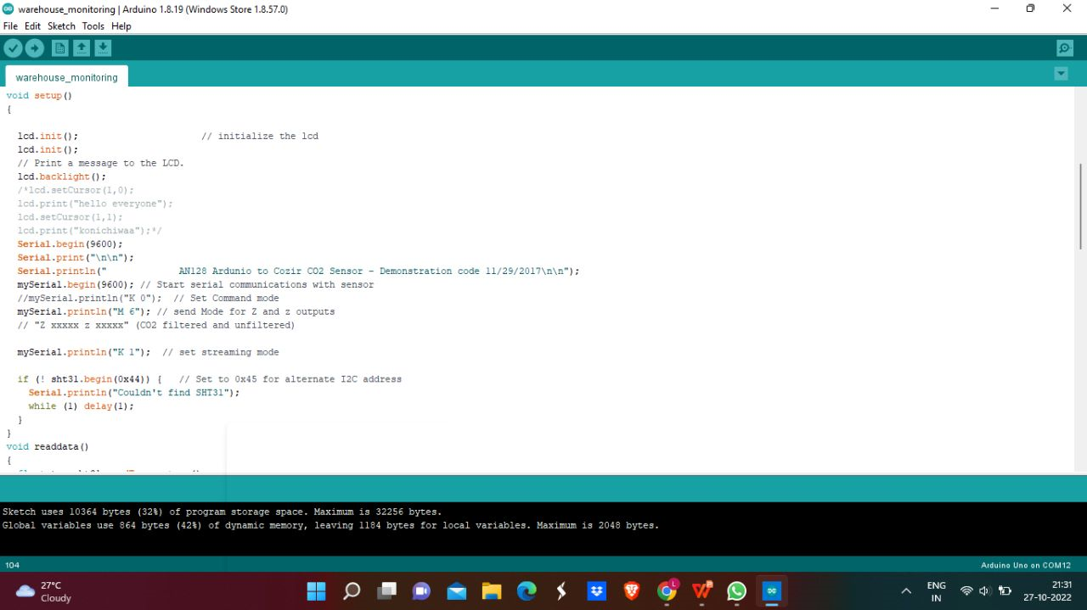
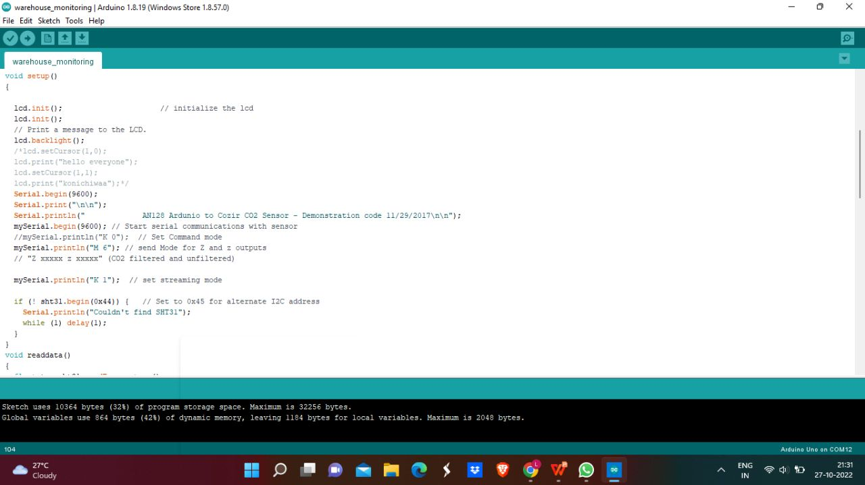
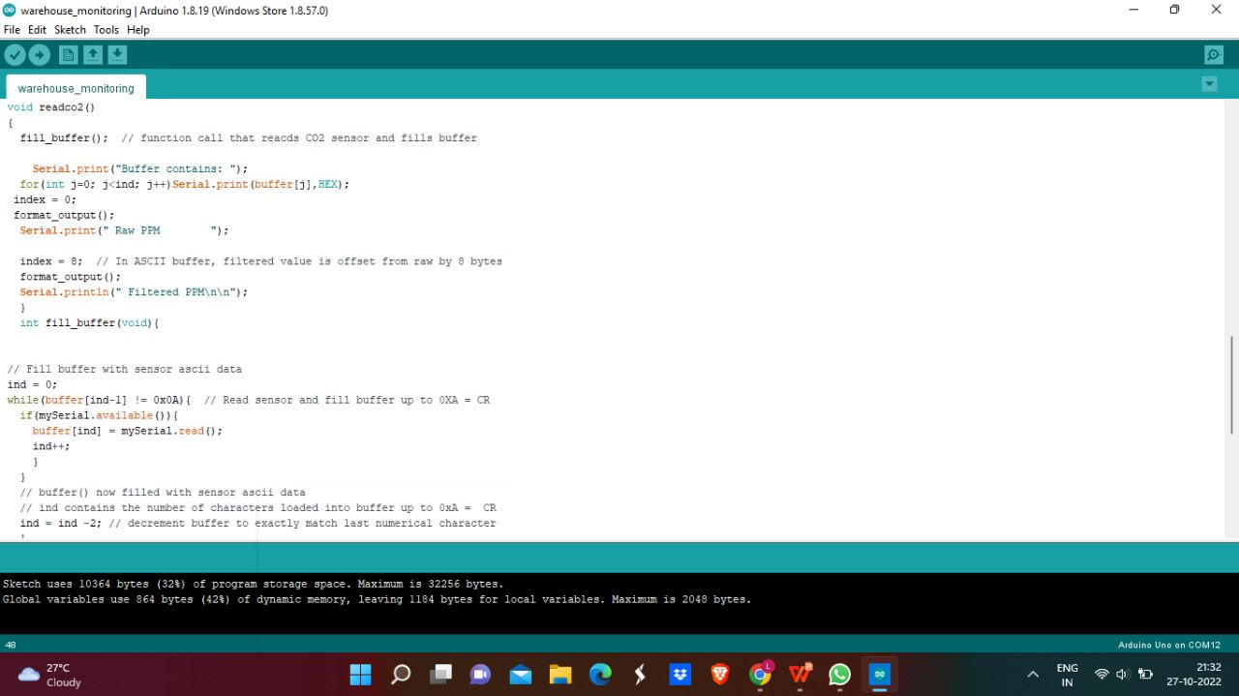
IMPLEMENTATION
TECHNICAL SUPPORT
We are using arduino for the implementation.
CODE:

Slide 11
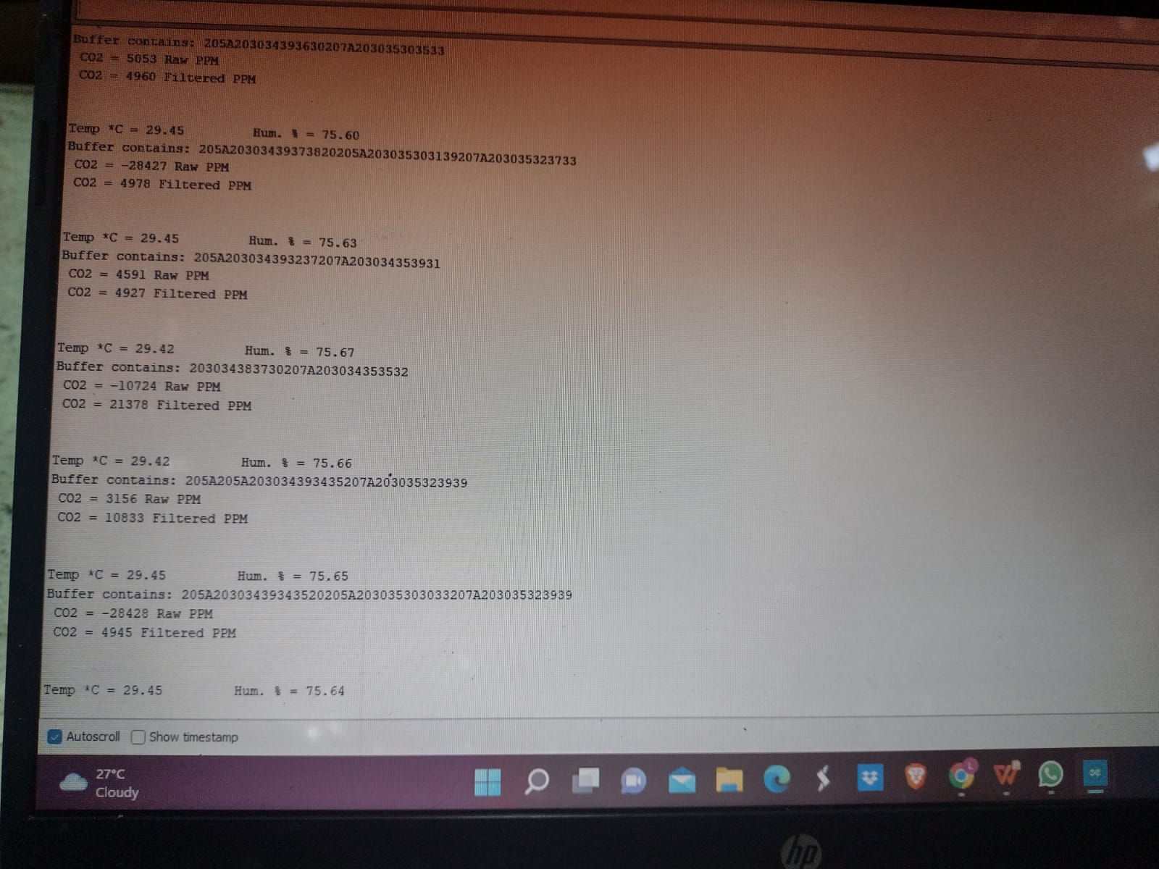
IMPLEMENTATION
SAMPLE OUTPUT

Slide 12
ADVANTAGES
This methods used to achieve the quality of the grains.
optimizes a warehouse's internal operation which can then extend to the broader supply chain.
no wastage of money
Meet Urgent Demand
Keep Goods Safe. ...
Keep Your Food from Going Bad
Saves a Business a Great Deal of Money.

Slide 13
FUTURE ENHANCEMENT
In future, on considering the threshold of the signals we are able to identify the specific reason for the problem in the grains.
In case of fire accident, an alarm can be setup to give alert and safe them from the disaster and safeguard the humans and the grains.

Slide 14
THANK YOU

